Slide 1

Development of Software for Parameter Estimation and its Application on Wind Power Plant Equivalent Model
Gabriel José Negrelli Gomes
Advisor: Prof. Dr. Elmer Pablo Tito Cari
São Carlos School of Engineering - EESC
University of São Paulo - USP

Slide 2
Introduction
Increase in renewables participation
Mainly solar and wind energy
Clean alternative to fossil fuels
Rely on weather condition

Slide 3
Introduction
Worldwide increase leaded by:
United States
China
European Union
2010 bill
Reduce greenhouse emissions by 20% (1990 levels)
20% share of renewables by 2020

Slide 4
Introduction
Brazilian Panorama:
2002 bill
Creates PROINFA
Increase wind, solar, small hydro and biomass share
Renewables supplying 10% of energy by 2024

Slide 5
Wind Energy
Wind energy benefited from these policies
European Union:
417 TWh in 2019
15% of electricity demand (1% higher than 2018)
192 GW of installed capacity (UK included)

Slide 6
Wind Energy
Source: WindEurope, 2020

Slide 7
Wind Energy
Brazil
48.5 TWh in 2018 (Itaipu: 96.5 TWh)
8.1% of electricity demand (14.4% higher than 2017)
15.5 GW of installed capacity

Slide 8
Wind Energy
Source: ABEEolica, 2020

Slide 9
Wind Energy
Brazil
Energy yield yet to be explored
Potential to generate 272 TWh
144 TWh in the Northeast Region
Complimentary regimes of wind and water (São Francisco River)

Slide 10
Wind Energy
Source: ANEEL, 2005

Slide 11
Wind Energy
Growth expectations for this source
Disadvantages:
Stochastic source
Not evenly distributed
Generators with low inertia
Affects system stability

Slide 12
Wind Energy
Study of effects of these plants on stability
Need of mathematical models
Multiple generators
Equivalent model
Source: Adapted from (MULJADI; ELLIS, 2008)

Slide 13
Wind Turbine Generators
Huge variety of generators
Task force to develop generic models
Four types of wind turbine generators
Representation of wind power plants by one machine

Slide 14
Wind Turbine Generators
Type-1 Wind Turbine (SCIG):
Squirrel-Cage Induction Generator
Operates at constant speed
Reactive compensation

Slide 15
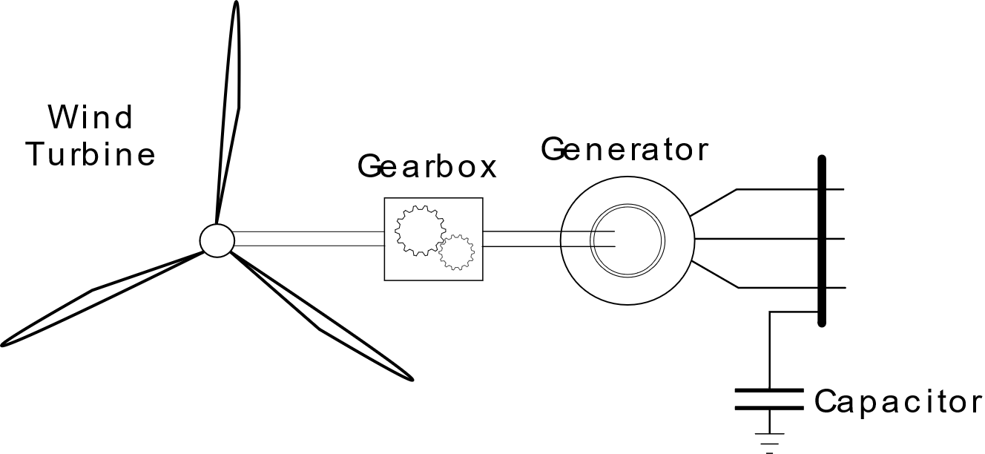
Wind Turbine Generators
Type-1 Wind Turbine (SCIG):

Slide 16
Wind Turbine Generators
Type-2 Wind Turbine (WRIG):
Wound Rotor Induction Generator
Rotor resistance variation
Reactive compensation

Slide 17
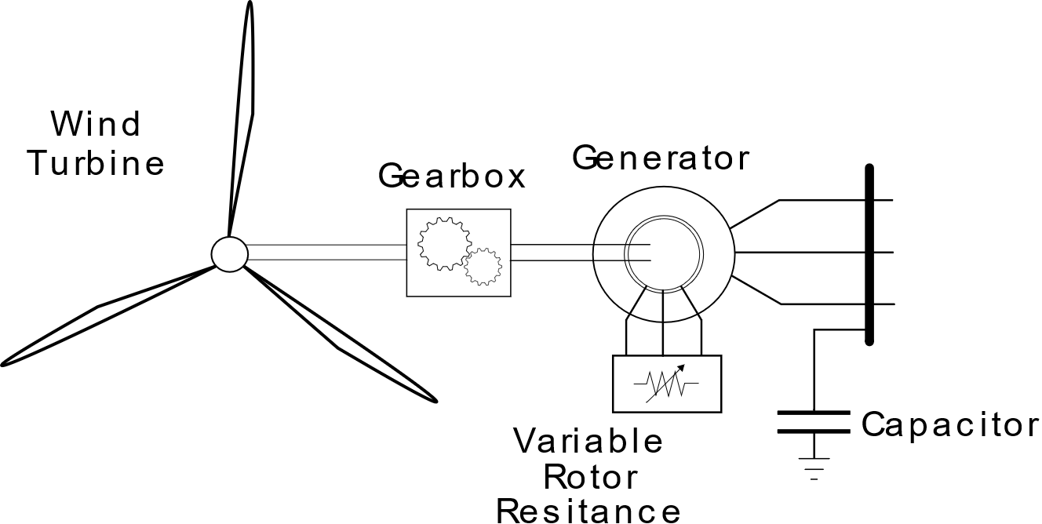
Wind Turbine Generators
Type-2 Wind Turbine (WRIG):

Slide 18
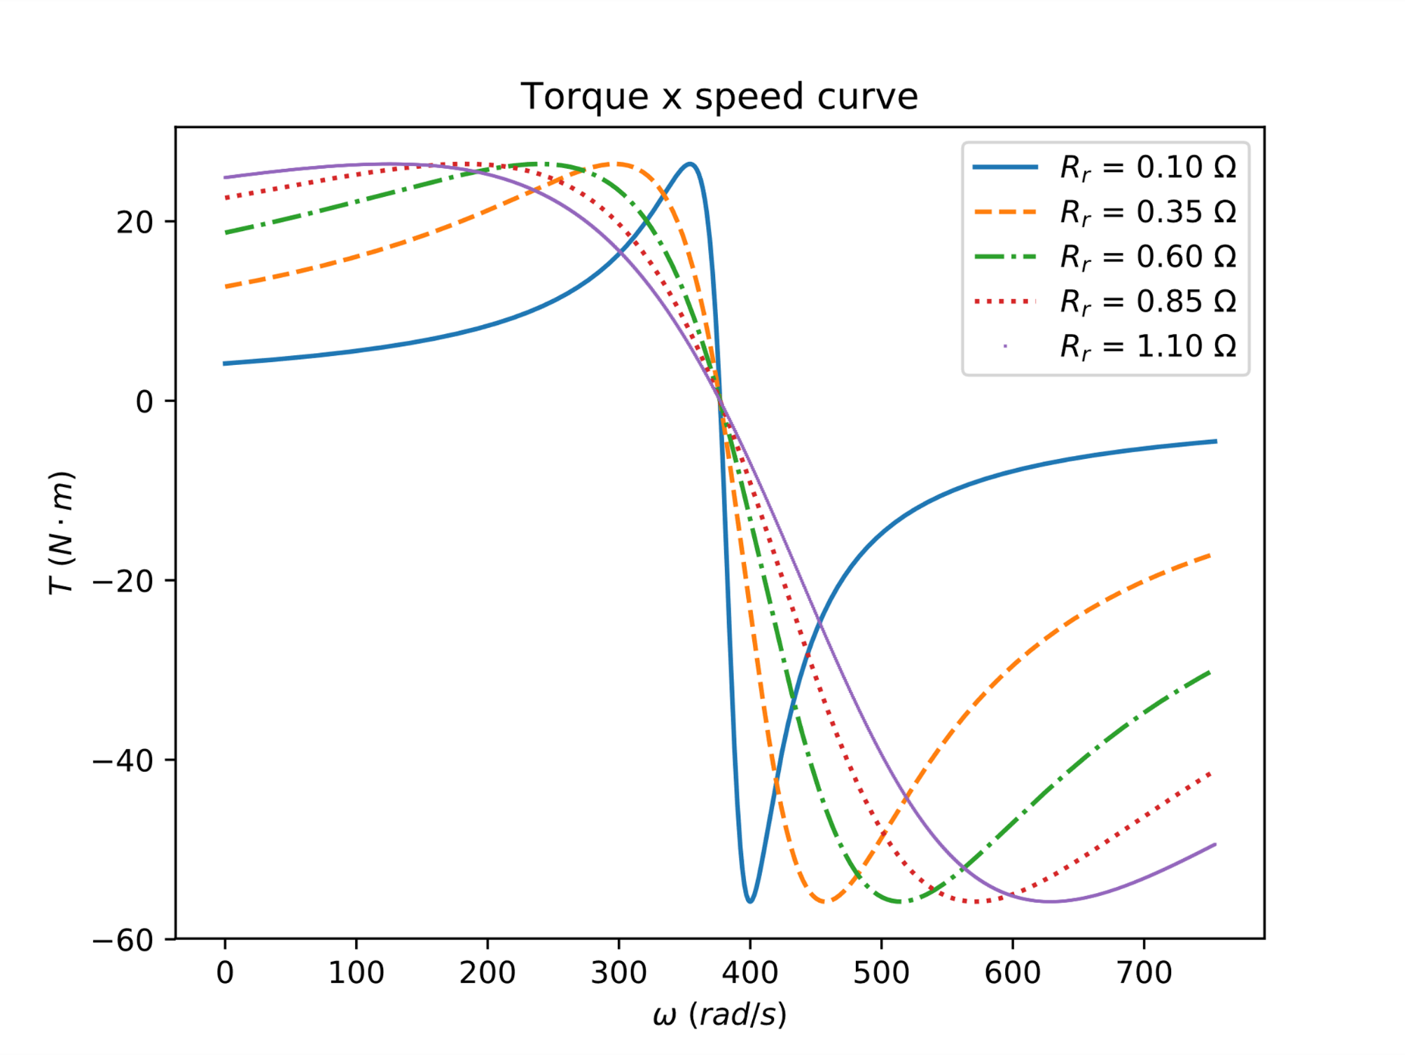
Wind Turbine Generators
Type-2 Wind Turbine (WRIG):
Alter torque-speed curve
Operates within a small speed range

Slide 19
Wind Turbine Generators
Type-3 Wind Turbine (DFIG):
Doubly Fed Induction Generator
Wound Rotor Induction Generator + frequency converter
Operates at ± 30% of rated speed
Reactive injection control

Slide 20
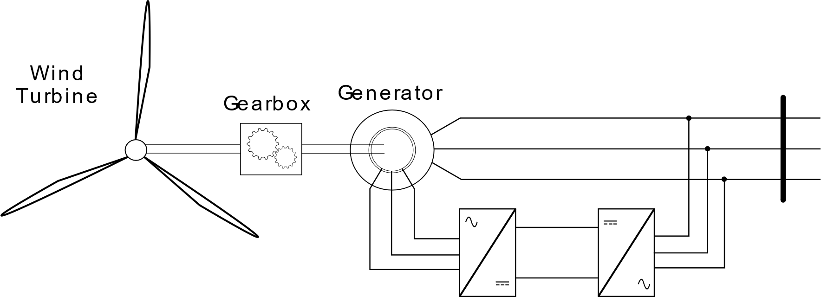
Wind Turbine Generators
Type-3 Wind Turbine (DFIG):

Slide 21
Wind Turbine Generators
Type-4 Wind Turbine:
Induction/Synchronous Generator
Grid connection through converter
Wide speed range
Reactive injection control

Slide 22
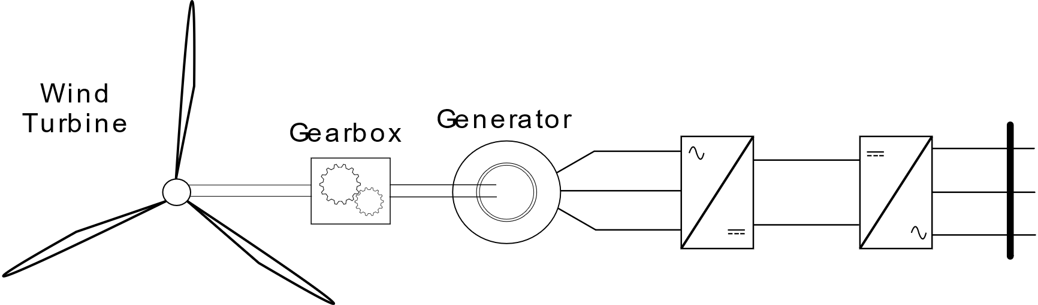
Wind Turbine Generators
Type-4 Wind Turbine:

Slide 23
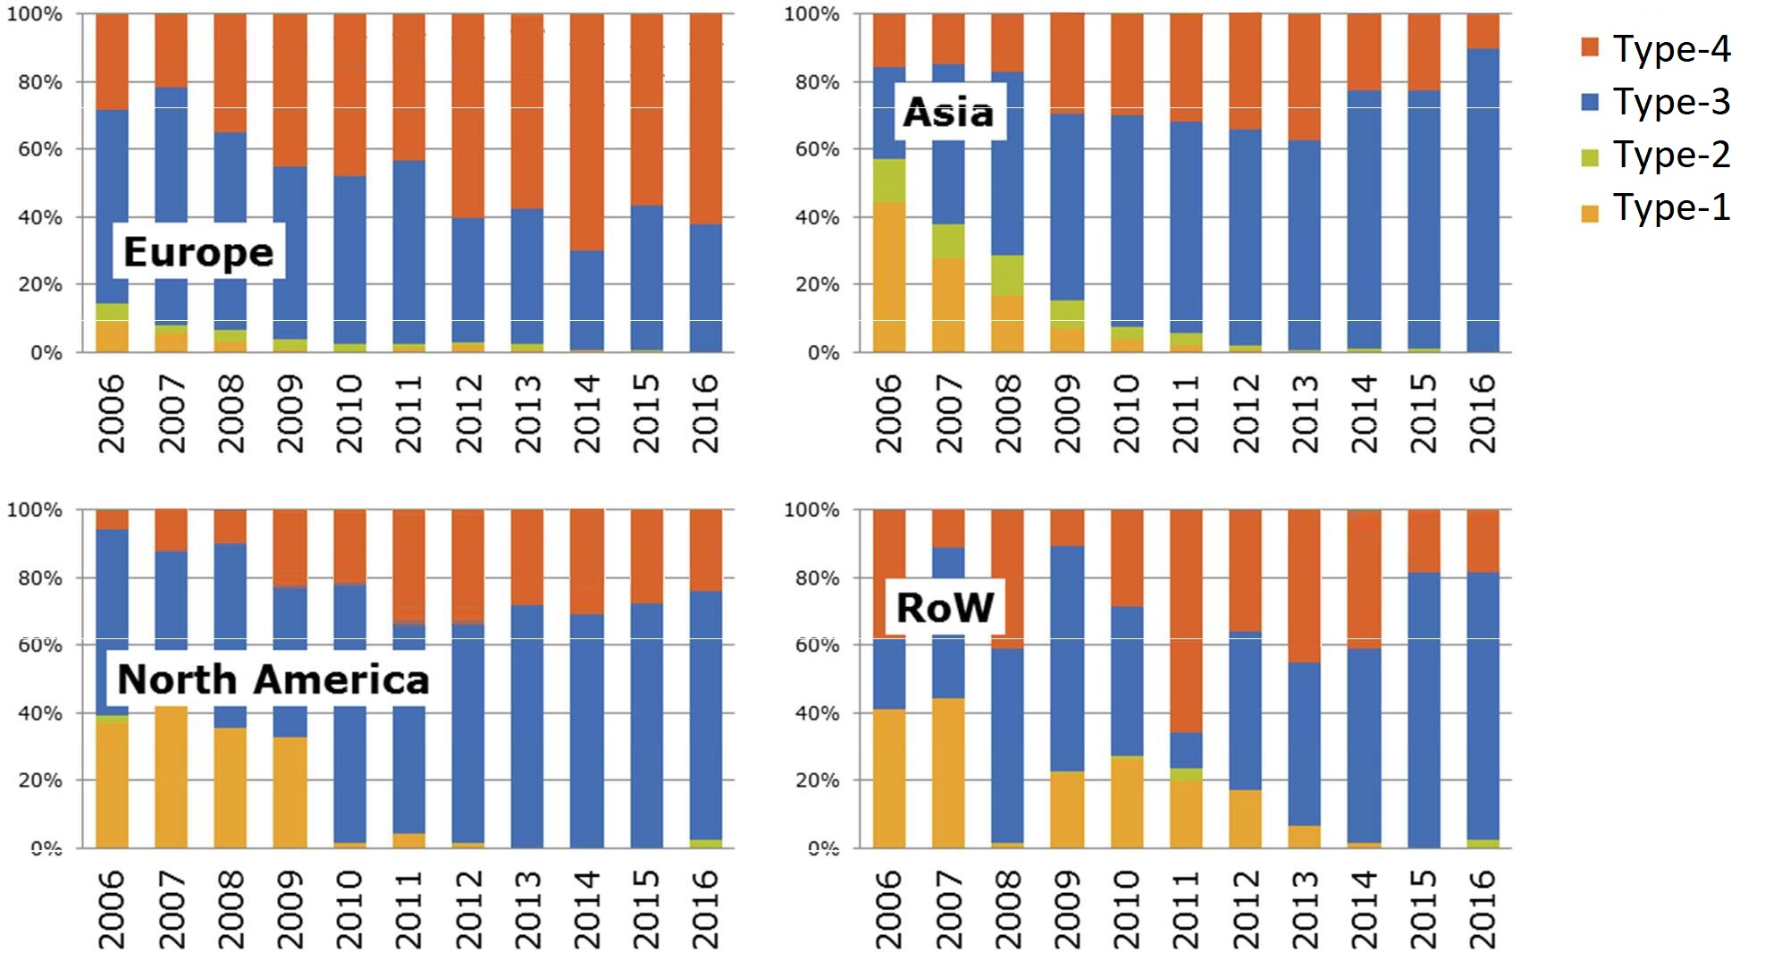
Wind Turbine Generators
Source: JRC, 2017

Slide 24
Wind Power Plant Model

Slide 25
Wind Power Plant Model
Represent Type-3 and -4 Generators
Behaviour of wind power plants
Transient studies

Slide 26
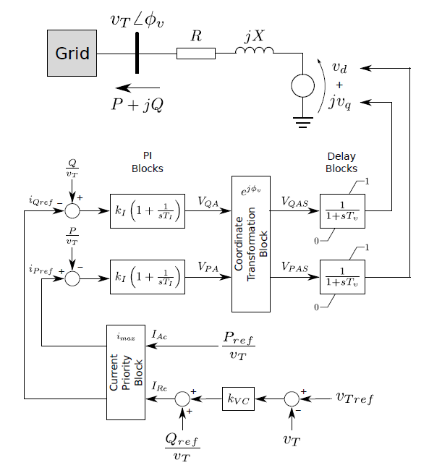
Wind Power Plant Model
Source: Adapted from (ERLICH et al., 2012)

Slide 27
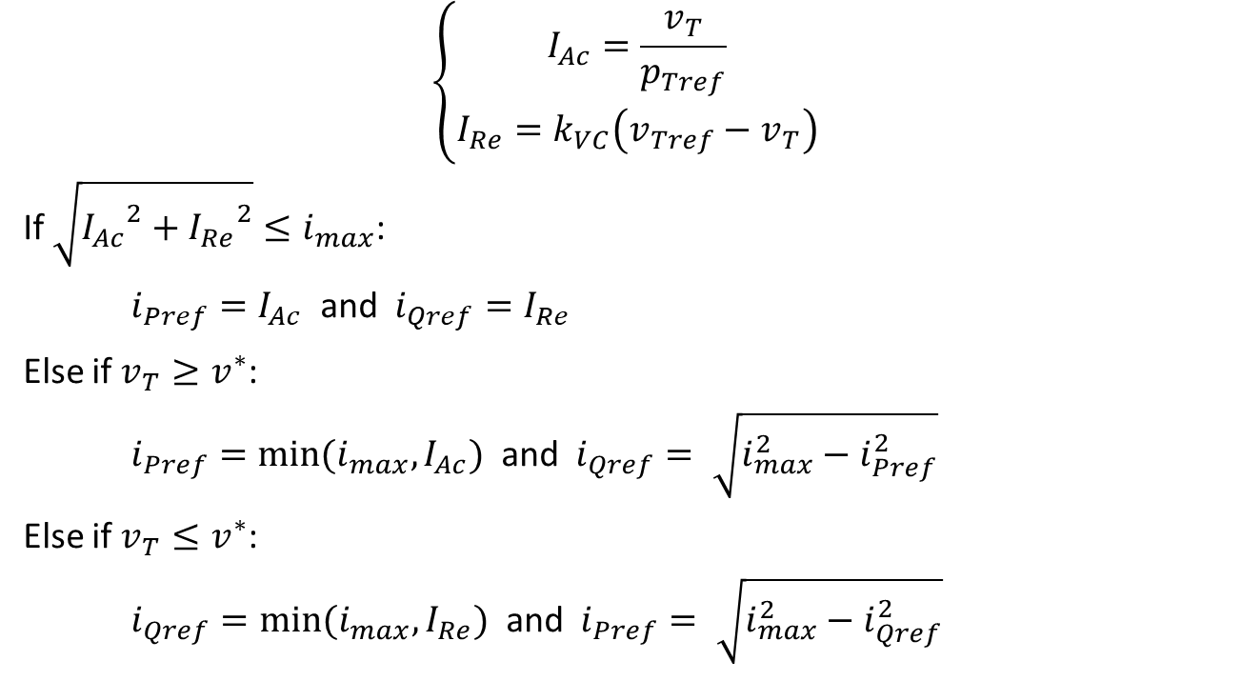
Wind Power Plant Model
$$\left\{\begin{aligned}I_{Ac}=\frac{v_{T}}{p_{Tref}} \\ I_{Re}=k_{VC}\left(v_{Tref}−v_{T}\right)\end{aligned}\right.$$
If $\sqrt{{I_{Ac}}^{2}+{I_{Re}}^{2}}≤i_{max}$:
$i_{Pref}=I_{Ac}$ and $i_{Qref}=I_{Re}$
Else if $v_{T}≥v^{∗}$:
$i_{Pref}=min⁡(i_{max}, I_{Ac})$ and $i_{Qref}= \sqrt{i_{max}^{2}−i_{Pref}^{2}}$
Else if $v_{T}≤v^{∗}$:
$i_{Qref}=min⁡(i_{max}, I_{Re})$ and $i_{Pref}= \sqrt{i_{max}^{2}−i_{Qref}^{2}}$

Slide 28
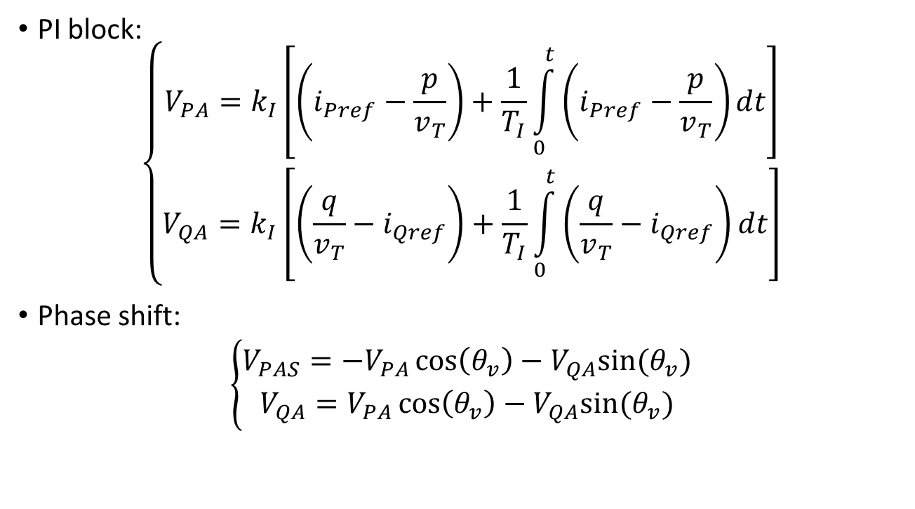
Wind Power Plant Model
PI block:
$$\left\{\begin{aligned}V_{PA}=k_{I}\left[\left(i_{Pref}−\frac{p}{v_{T}}\right)+\frac{1}{T_{I}}\int_{0}^{t}{\left(i_{Pref}−\frac{p}{v_{T}}\right)dt}\right] \\ V_{QA}=k_{I}\left[\left(\frac{q}{v_{T}}−i_{Qref}\right)+\frac{1}{T_{I}}\int_{0}^{t}{\left(\frac{q}{v_{T}}−i_{Qref}\right)dt}\right]\end{aligned}\right.$$
Phase shift:
$$\left\{\begin{aligned}V_{PAS}=−V_{PA}\cos\left(θ_{v}\right)−V_{QA}sin⁡(θ_{v}) \\ V_{QA}=V_{PA}\cos\left(θ_{v}\right)−V_{QA}sin⁡(θ_{v})\end{aligned}\right.$$

Slide 29
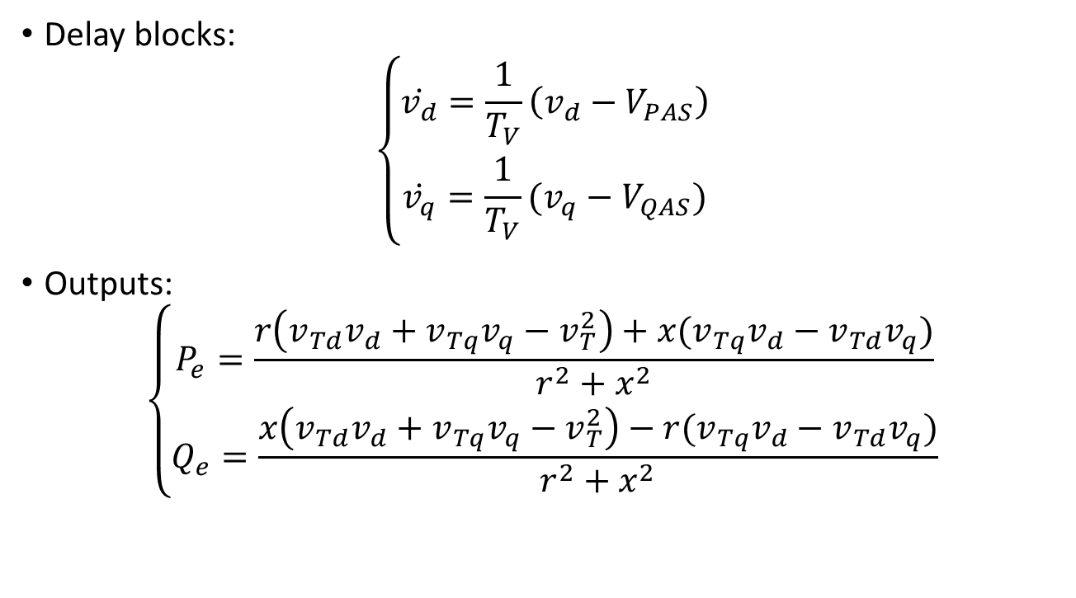
Wind Power Plant Model
Delay blocks:
$$\left\{\begin{aligned}\dot{v_{d}}=\frac{1}{T_{V}}\left(v_{d}−V_{PAS}\right) \\ \dot{v_{q}}=\frac{1}{T_{V}}(v_{q}−V_{QAS})\end{aligned}\right.$$
Outputs:
$$\left\{\begin{aligned}P_{e}=\frac{r\left(v_{Td}v_{d}+v_{Tq}v_{q}−v_{T}^{2}\right)+x(v_{Tq}v_{d}−v_{Td}v_{q})}{r^{2}+x^{2}} \\ Q_{e}=\frac{x\left(v_{Td}v_{d}+v_{Tq}v_{q}−v_{T}^{2}\right)−r(v_{Tq}v_{d}−v_{Td}v_{q})}{r^{2}+x^{2}}\end{aligned}\right.$$

Slide 30
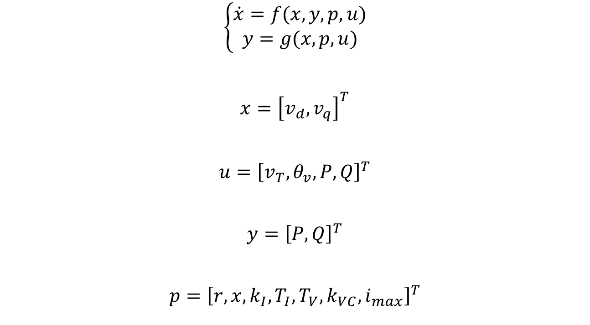
Wind Power Plant Model
$$\left\{\begin{aligned}\dot{x}=f(x,y,p,u) \\ y=g(x,p,u)\end{aligned}\right.$$
$$x={\left[v_{d}, v_{q}\right]}^{T}$$
$$u={\left[v_{T},θ_{v},P,Q\right]}^{T}$$
$$y={\left[P, Q\right]}^{T}$$
$$p={\left[r,x,k_{I},T_{I},T_{V},k_{VC}, i_{max}\right]}^{T}$$

Slide 31
Wind Power Plant Model
Represent Type-3 and -4 Generators
Behaviour of wind power plants
Transient studies

Slide 32
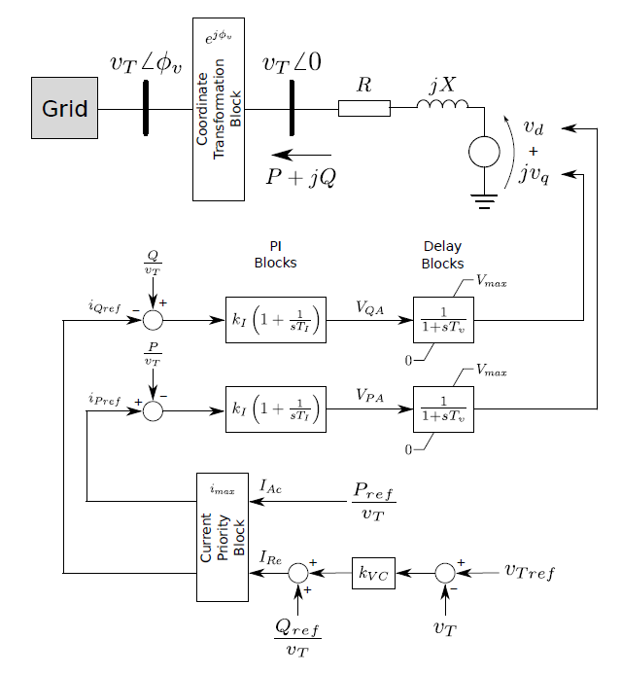
Wind Power Plant Model
Source: Adapted from (ERLICH et al., 2012)

Slide 33
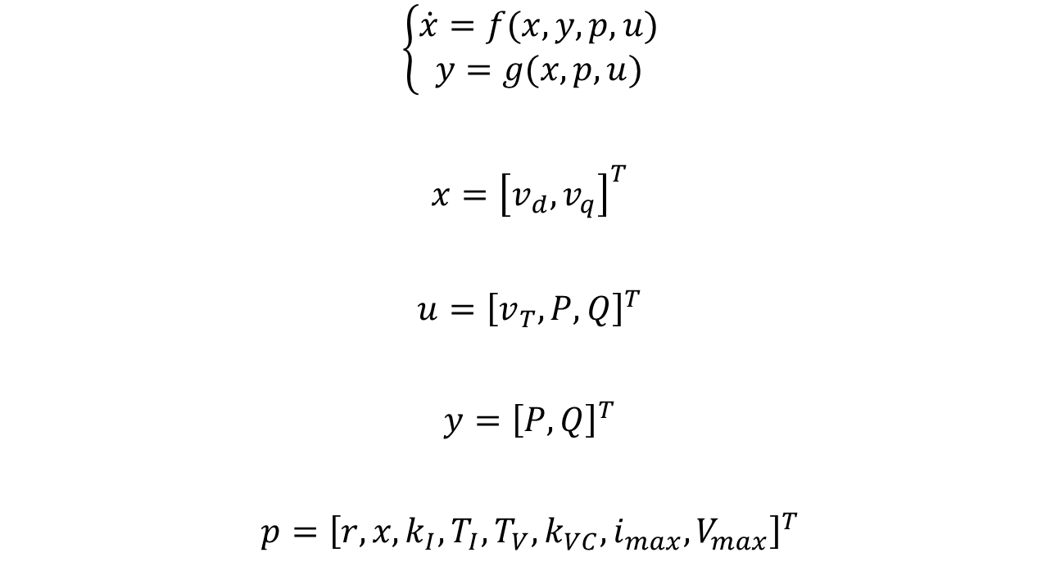
Wind Power Plant Model
$$\left\{\begin{aligned}\dot{x}=f(x,y,p,u) \\ y=g(x,p,u)\end{aligned}\right.$$
$$x={\left[v_{d}, v_{q}\right]}^{T}$$
$$u={\left[v_{T}, P,Q\right]}^{T}$$
$$y={\left[P, Q\right]}^{T}$$
$$p={\left[r,x,k_{I},T_{I},T_{V},k_{VC},i_{max},V_{max}\right]}^{T}$$

Slide 34
Parameter Estimation Method

Slide 35
Parameter Estimation Method

Slide 36
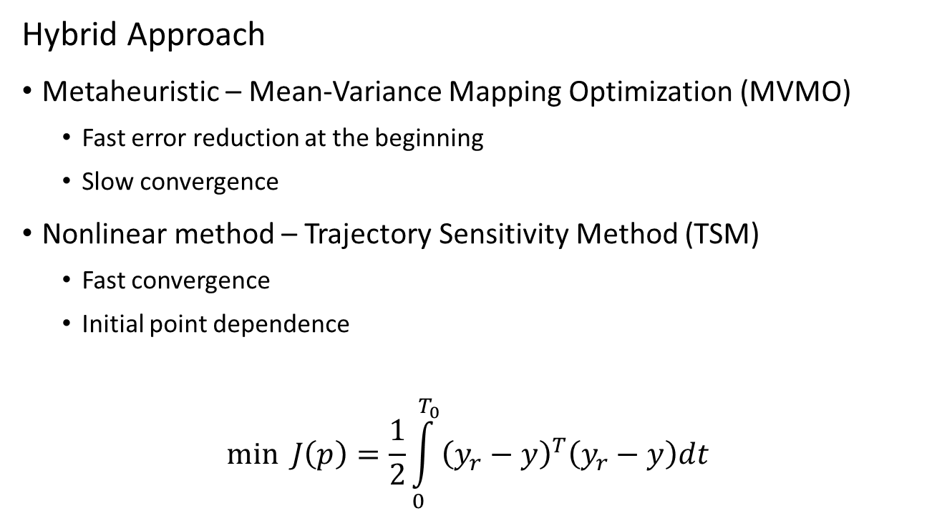
Parameter Estimation Method
Hybrid Approach
Metaheuristic – Mean-Variance Mapping Optimization (MVMO)
Fast error reduction at the beginning
Slow convergence
Nonlinear method – Trajectory Sensitivity Method (TSM)
Fast convergence
Initial point dependence
$$\min{J\left(p\right)=\frac{1}{2}\int_{0}^{T_{0}}{{\left(y_{r}−y\right)}^{T}\left(y_{r}−y\right)dt} }$$

Slide 37
MVMO
Population-based metaheuristic
Offspring considering population statistics
Great results for small populations

Slide 38
MVMO
Setup
Population size
Number of offspring
Number of genes for mutation
Selection method
Normalized search region

Slide 39




MVMO
Best
Worst

Slide 40
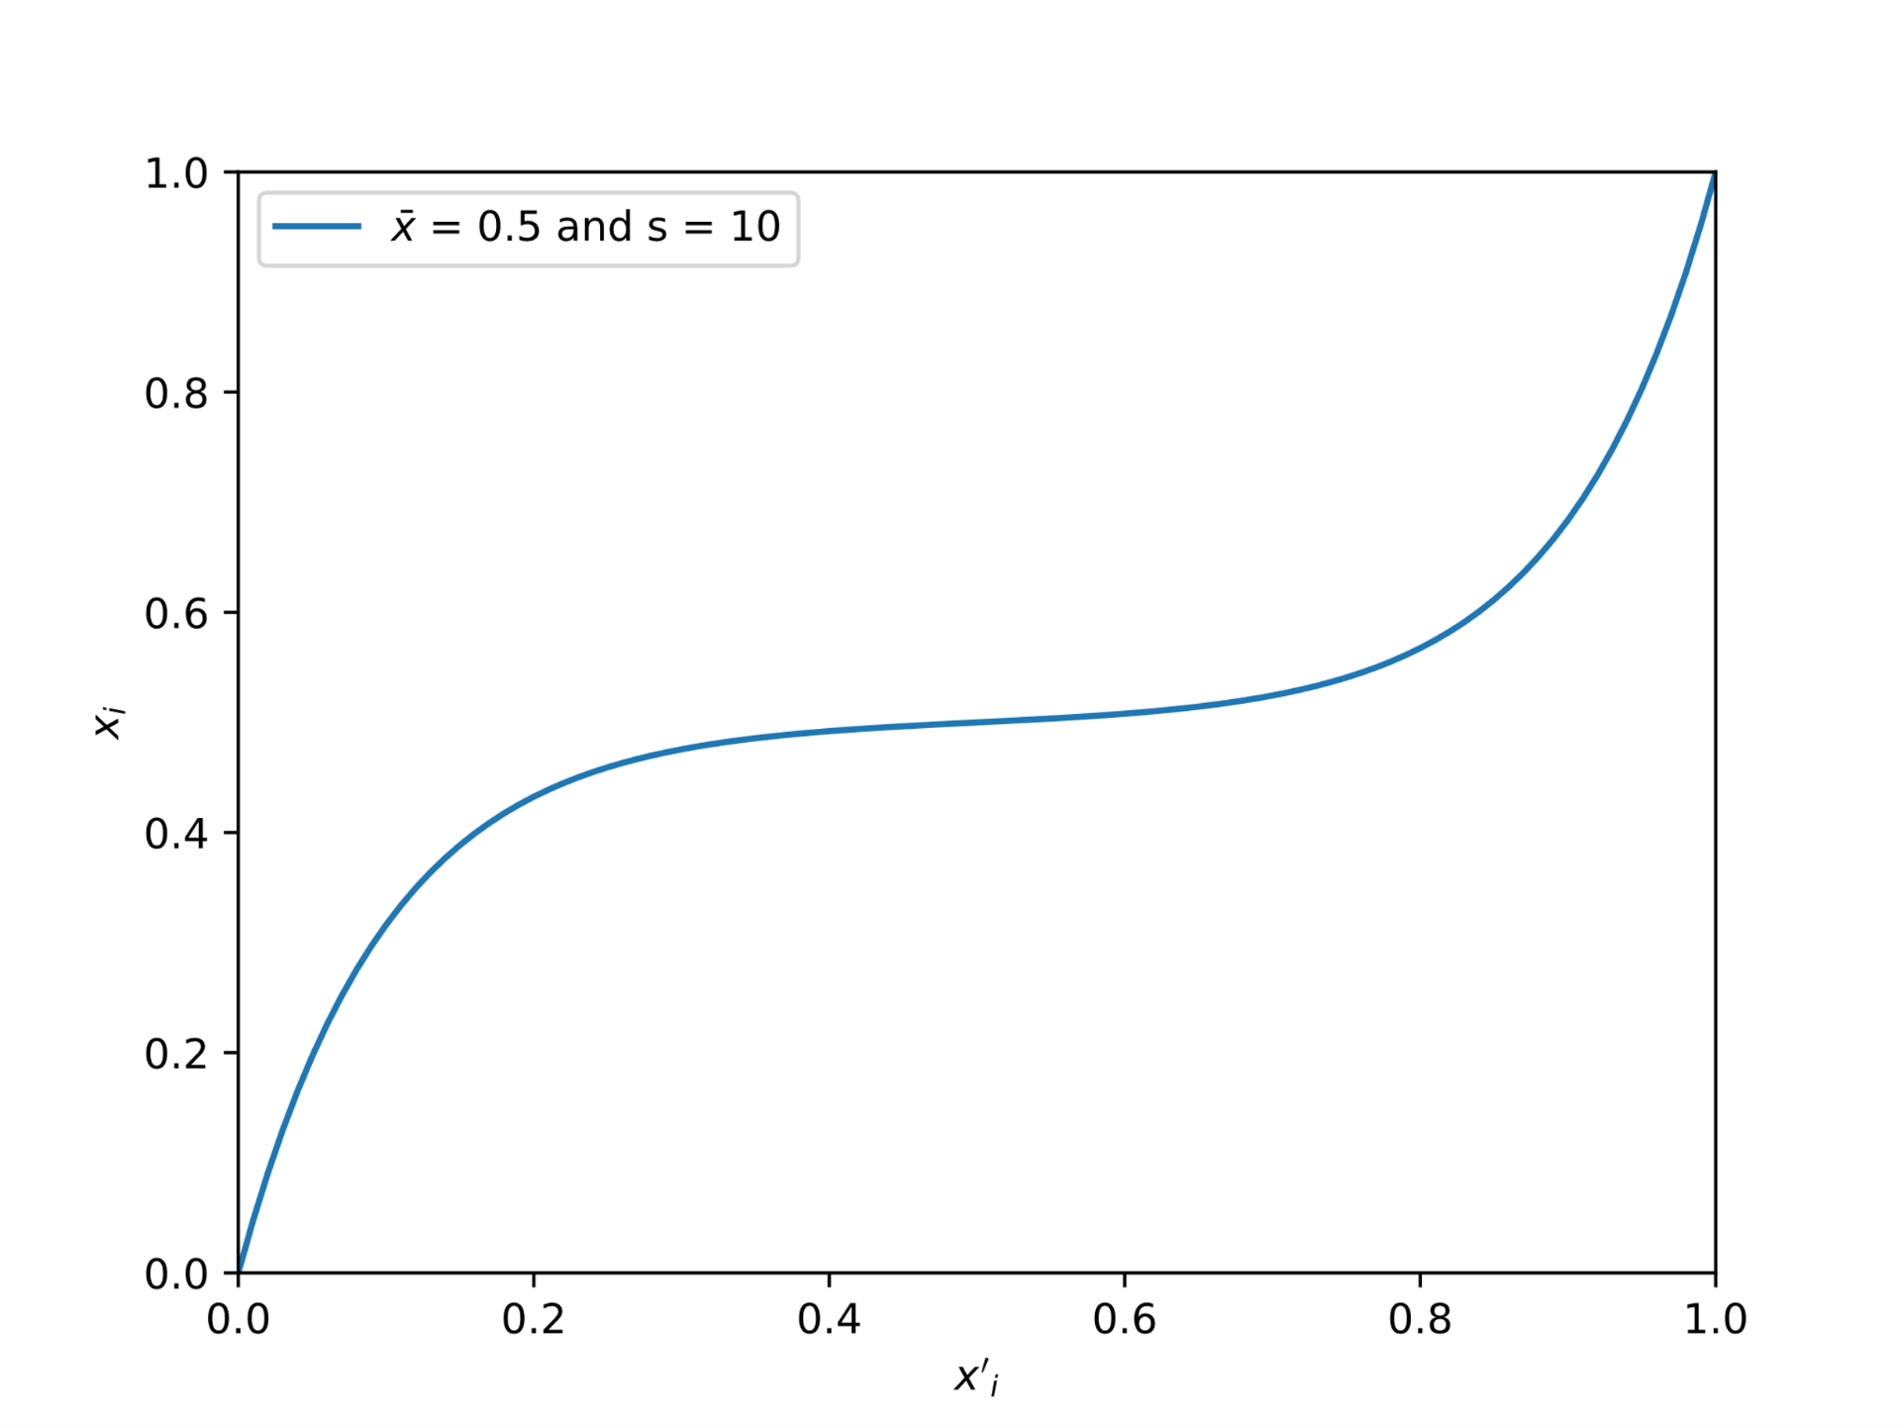
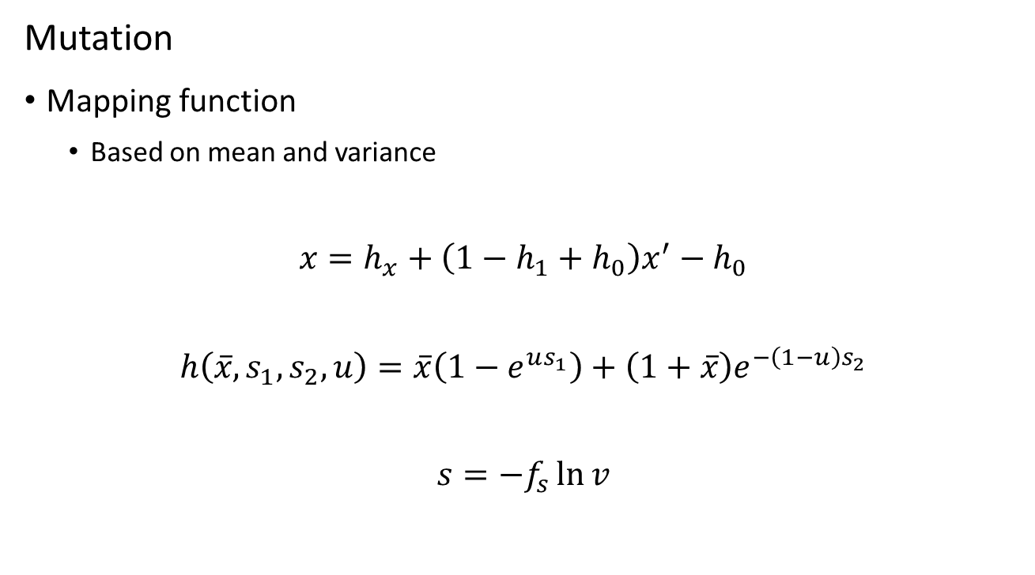
MVMO
Mutation
Mapping function
Based on mean and variance
$$x=h_{x}+\left(1−h_{1}+h_{0}\right)x^{′}−h_{0}$$
$$h\left(\overline{x},s_{1},s_{2},u\right)=\overline{x}\left(1−e^{us_{1}}\right)+\left(1+\overline{x}\right)e^{−\left(1−u\right)s_{2}}$$
$$s=−f_{s}\ln{v}$$

Slide 41
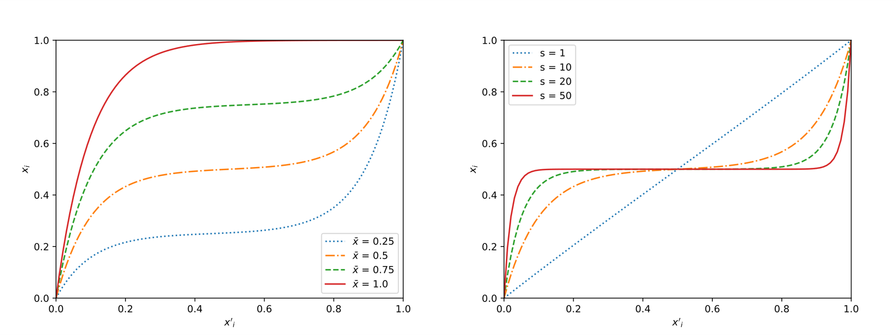
MVMO
Mean and variance effects

Slide 42
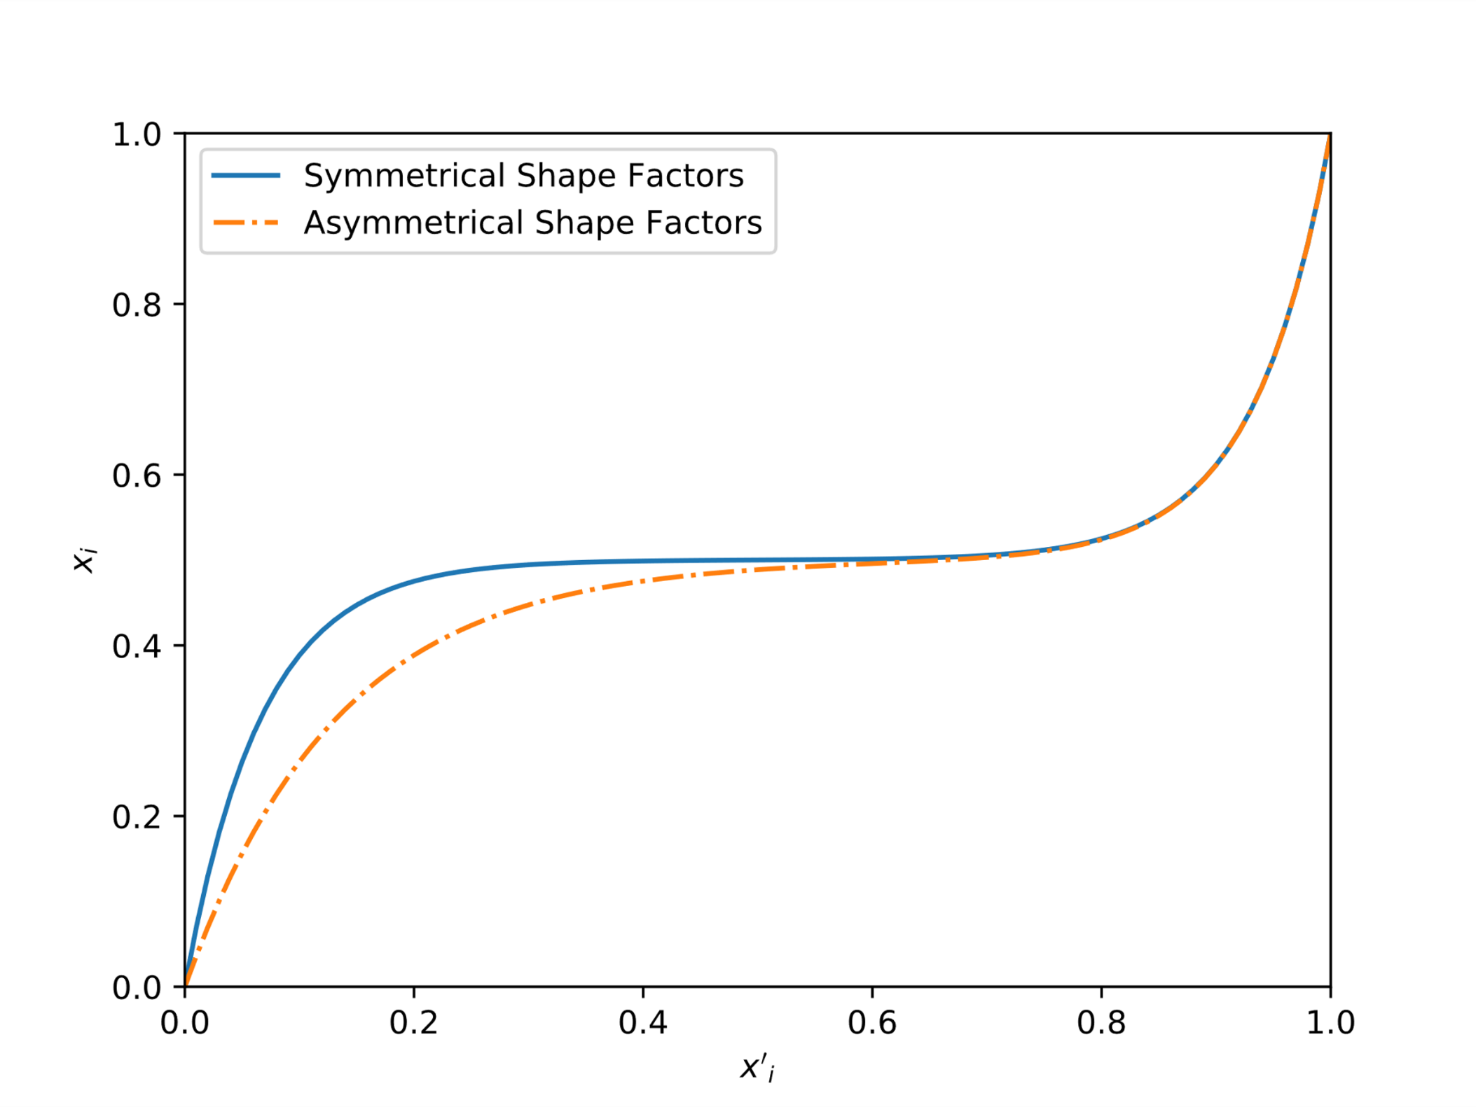
MVMO
Asymmetrical shape factors

Slide 43
TSM
Based on Newton-Raphson
Fast convergence
Initial values dependence

Slide 44
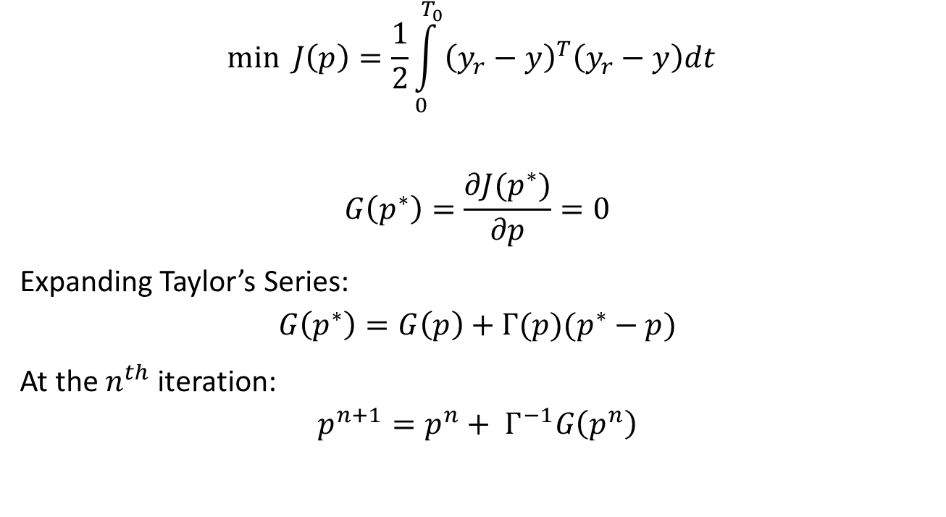
TSM
$$\min{J\left(p\right)=\frac{1}{2}\int_{0}^{T_{0}}{{\left(y_{r}−y\right)}^{T}\left(y_{r}−y\right)dt} }$$
$$G\left(p^{∗}\right)=\frac{∂J(p^{∗})}{∂p}=0$$
Expanding Taylor’s Series:
$$G\left(p^{∗}\right)=G\left(p\right)+Γ(p)(p^{∗}−p)$$
At the $n^{th}$ iteration:
$$p^{n+1}=p^{n}+ Γ^{−1}G\left(p^{n}\right)$$

Slide 45
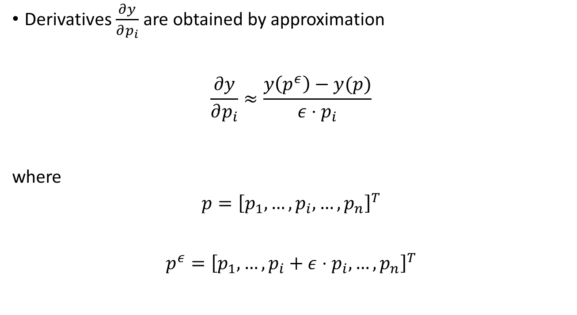
TSM
Derivatives $\frac{∂y}{∂p_{i}}$ are obtained by approximation
$$\frac{∂y}{∂p_{i}}≈\frac{y\left(p^{ε}\right)−y(p)}{ε⋅p_{i}}$$
where
$$p={\left[p_{1},…,p_{i},…,p_{n}\right]}^{T}$$
$$p^{ε}={\left[p_{1},…,p_{i}+ε⋅p_{i},…,p_{n}\right]}^{T}$$

Slide 46
Software Developed

Slide 47
Software
identPy:
Framework for parameter estimation
identPy_GUI:
Guided User Interface for framework
Python
Non-specific

Slide 48
Software

Slide 49
Results

Slide 50
Partial Results
Hybrid approach already implemented
Spring-Mass System
Linearized Z-IM Load Model

Slide 51
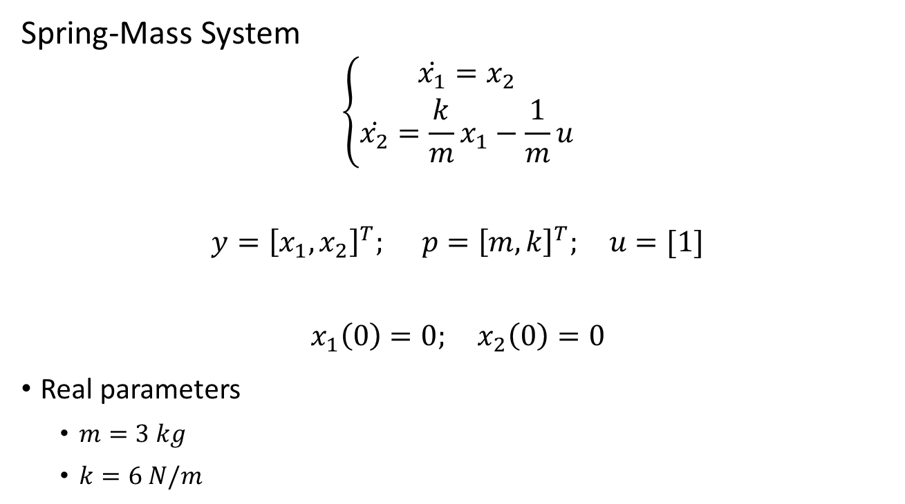
Partial Results
Spring-Mass System
$$\left\{\begin{aligned}\dot{x_{1}}=x_{2} \\ \dot{x_{2}}=\frac{k}{m}x_{1}−\frac{1}{m}u\end{aligned}\right.$$
$$y={\left[x_{1},x_{2}\right]}^{T}; p={\left[m,k\right]}^{T}; u=[1]$$
$$x_{1}\left(0\right)=0; x_{2}\left(0\right)=0$$
Real parameters
$m=3 kg$
$k=6 N/m$

Slide 52
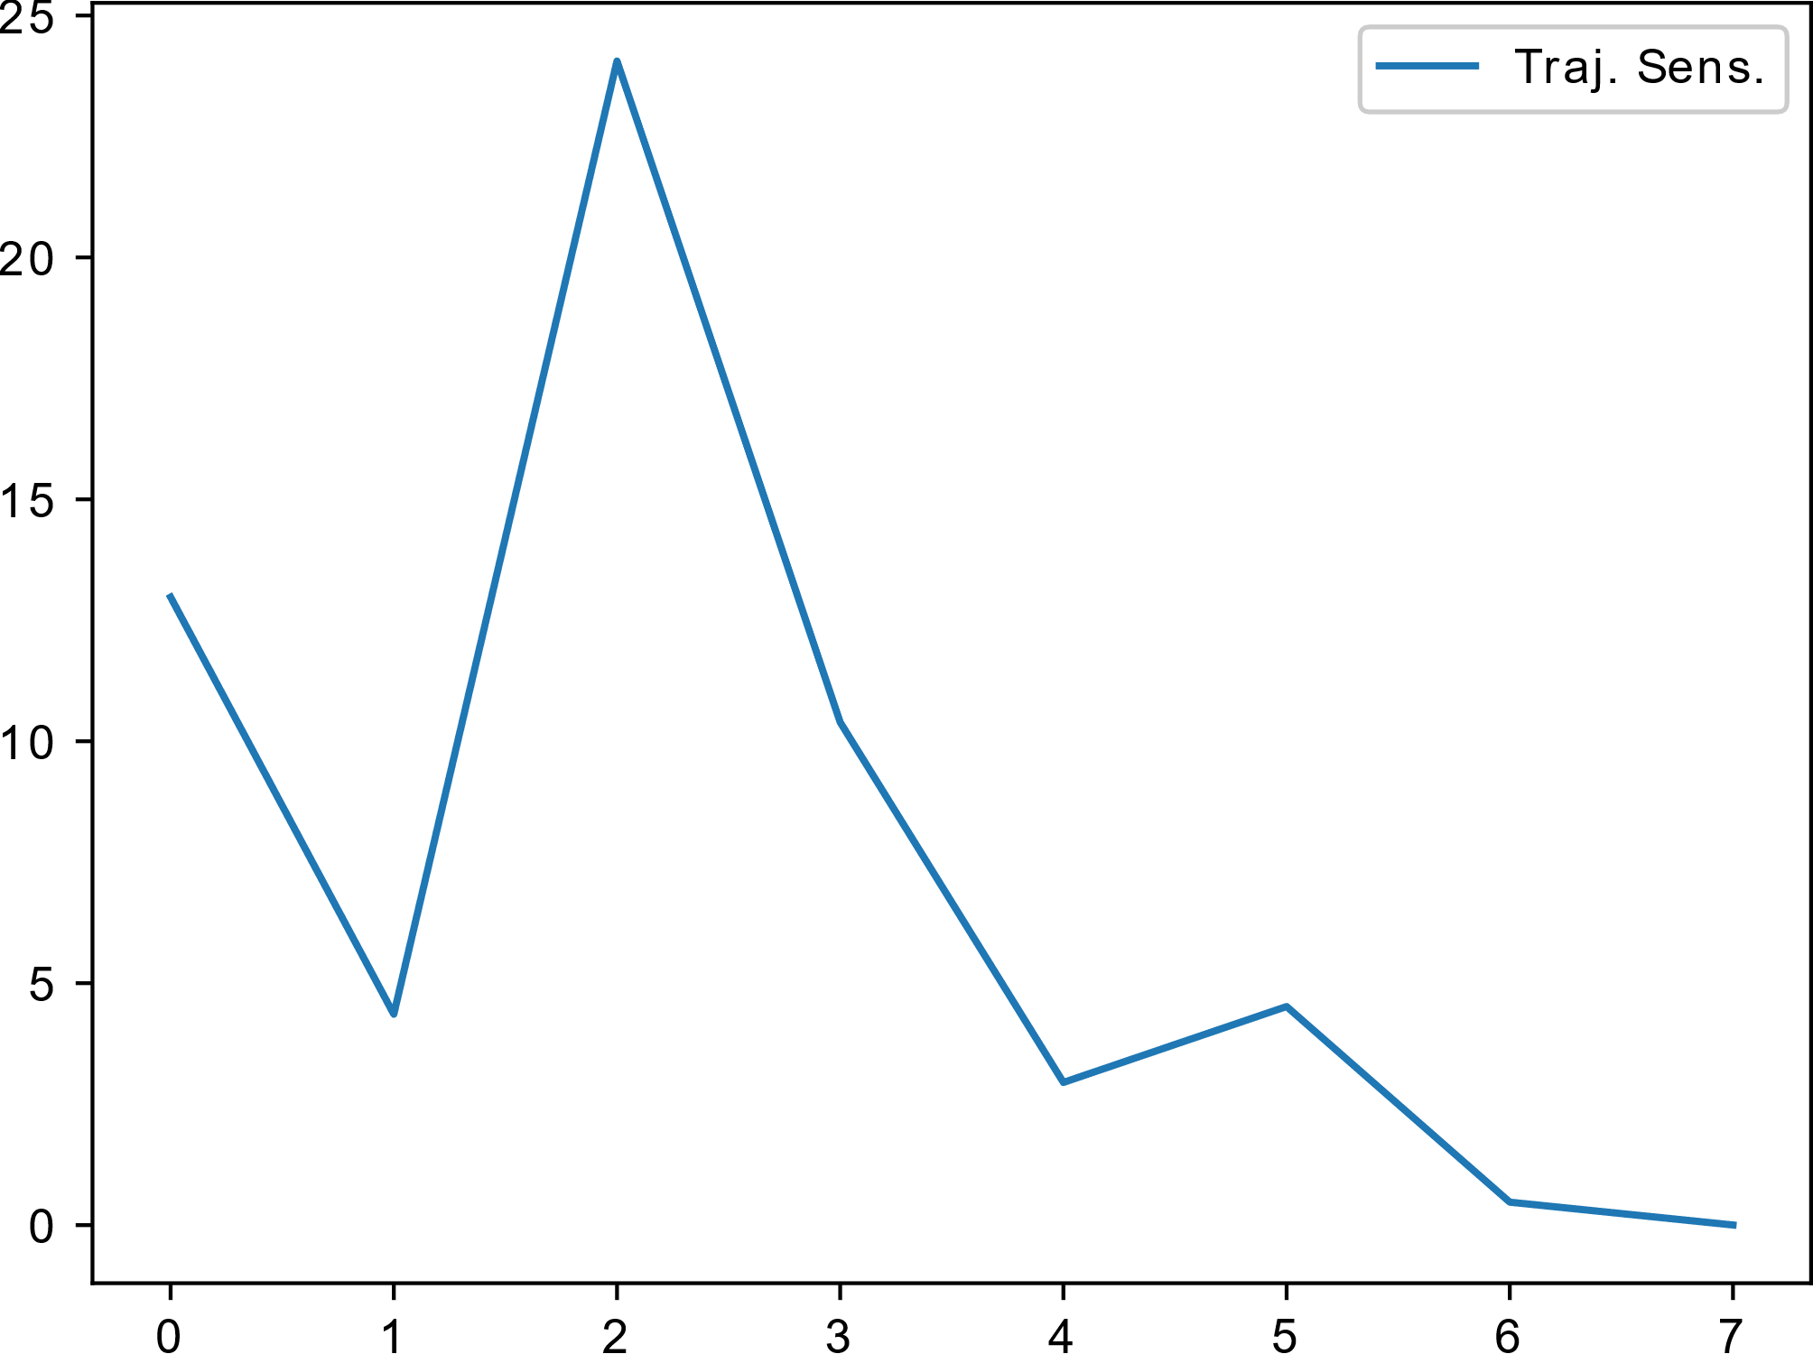
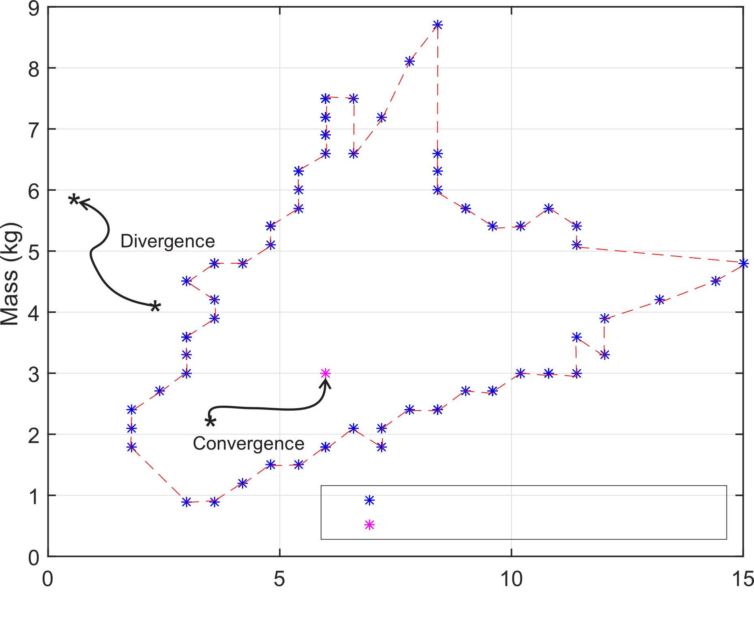
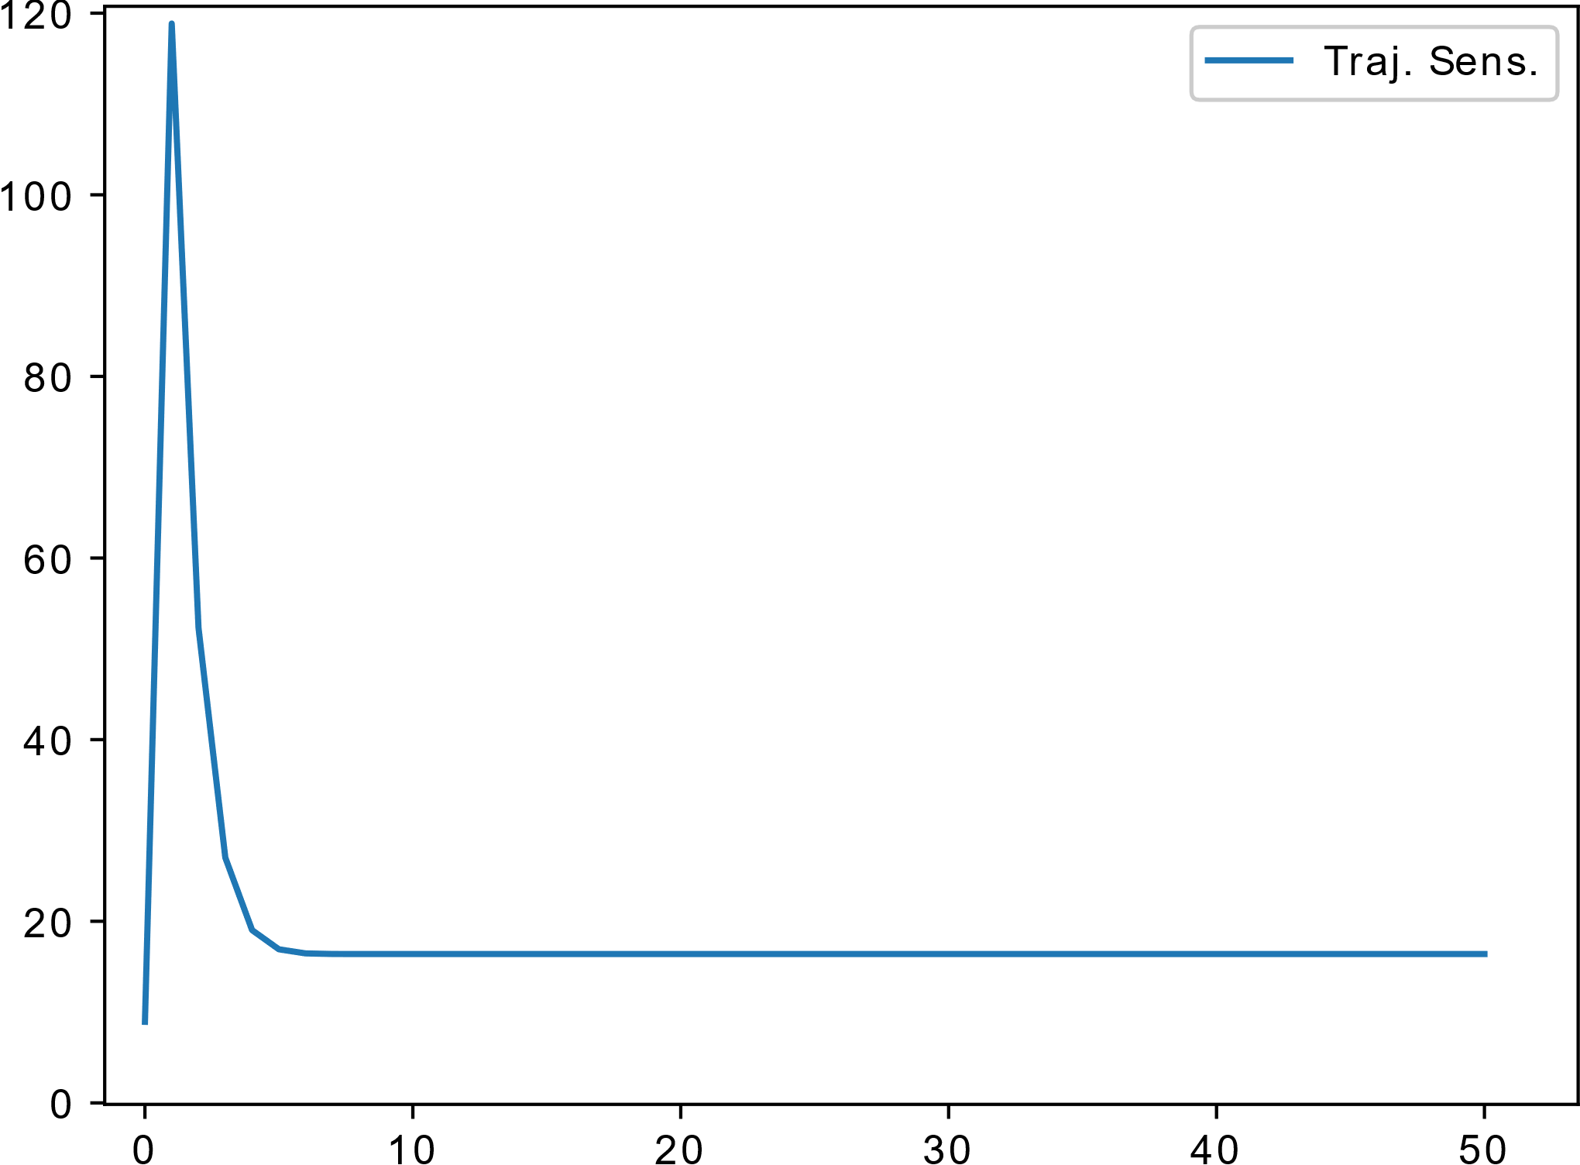
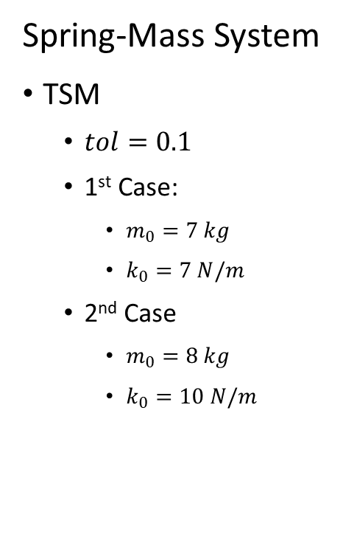
Partial Results
Spring-Mass System
TSM
$tol=0.1$
1st Case:
$m_{0}=7 kg$
$k_{0}=7 N/m$
2nd Case
$m_{0}=8 kg$
$k_{0}=10 N/m$
Source: Adapted from (FARIAS; CARI, 2016)

Slide 53
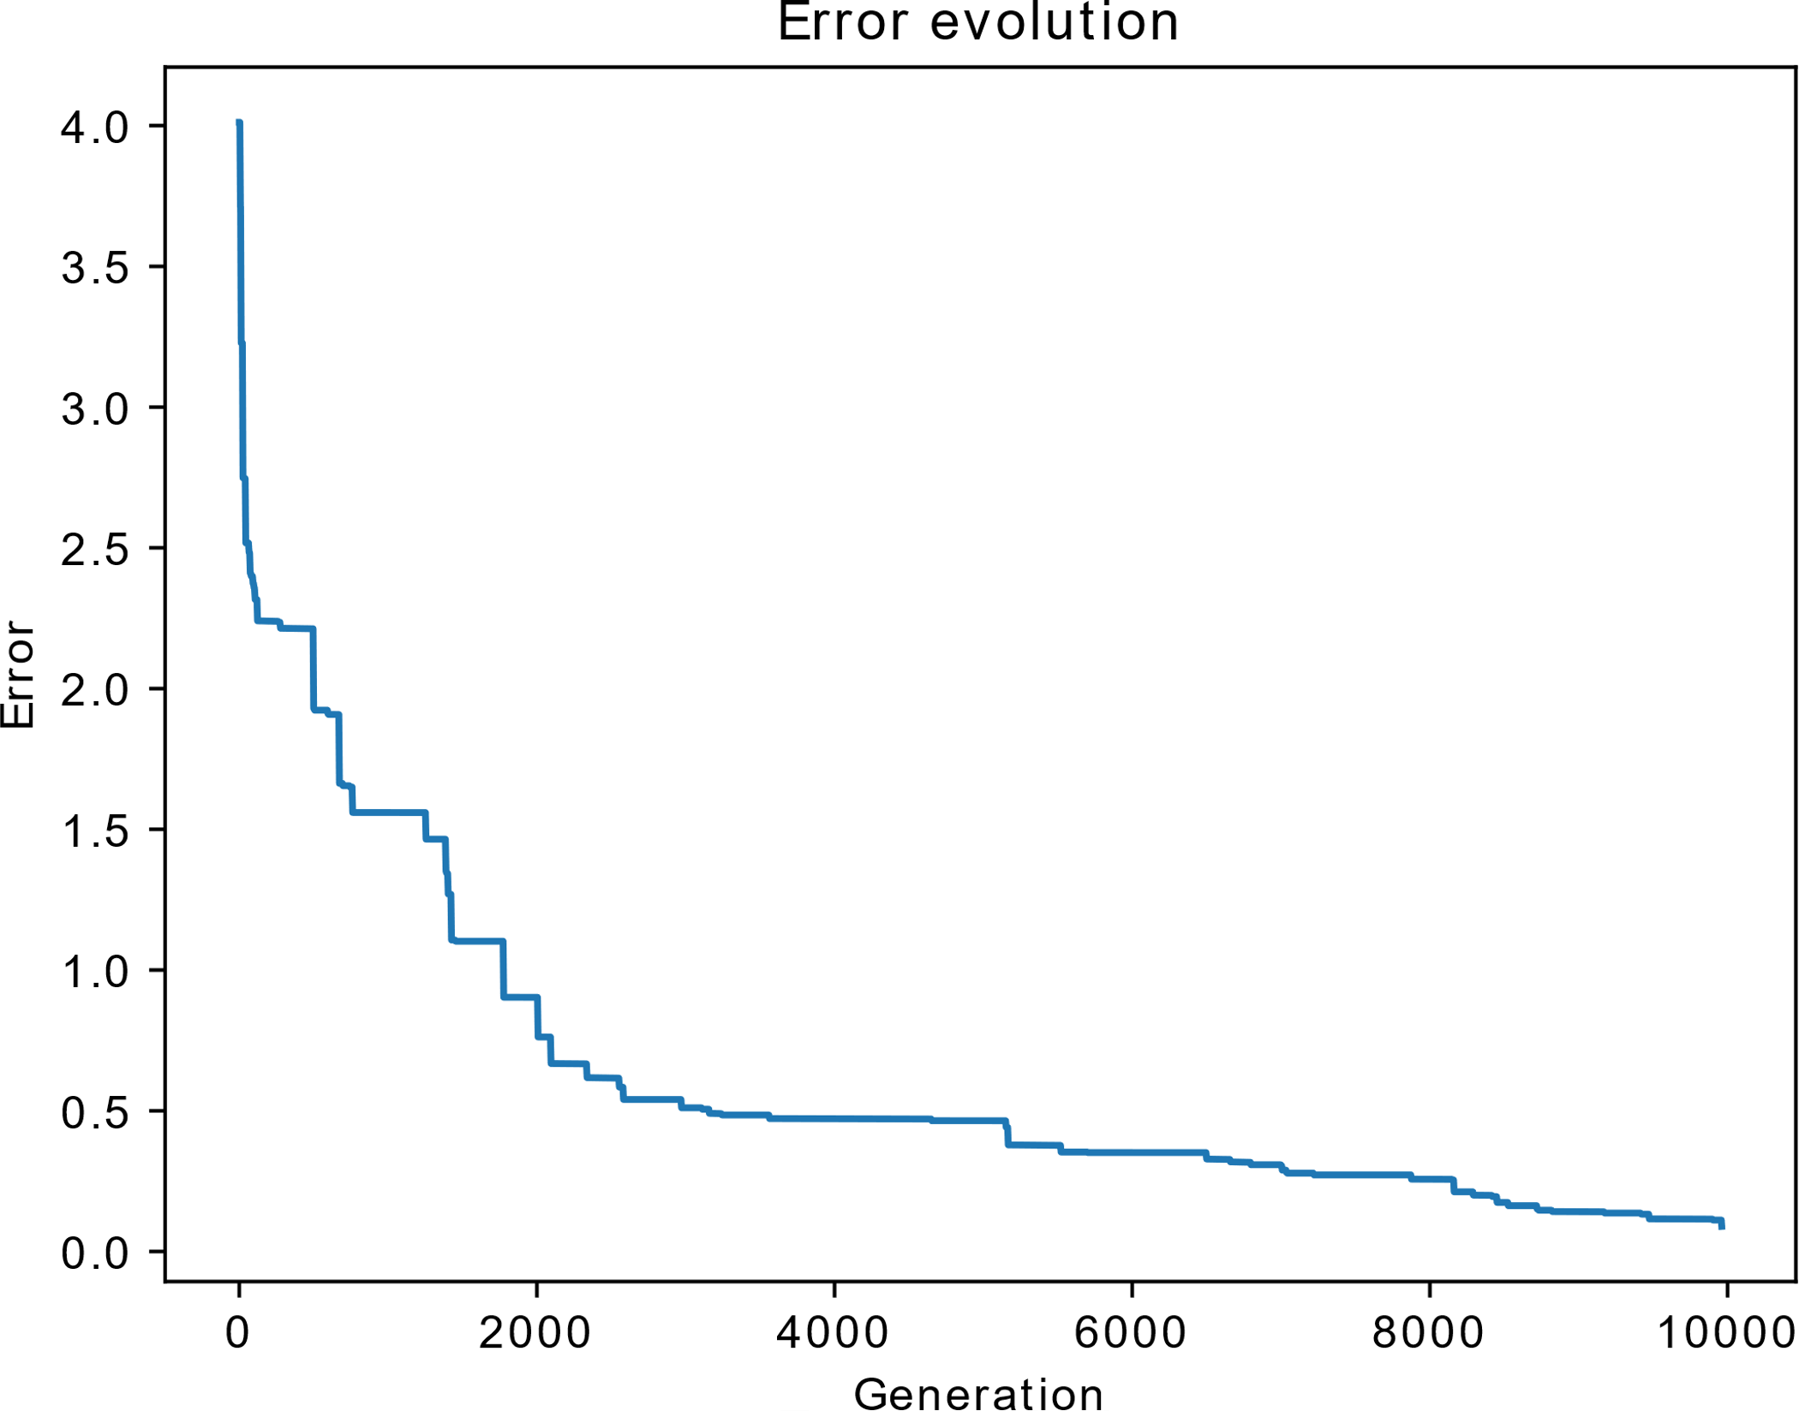
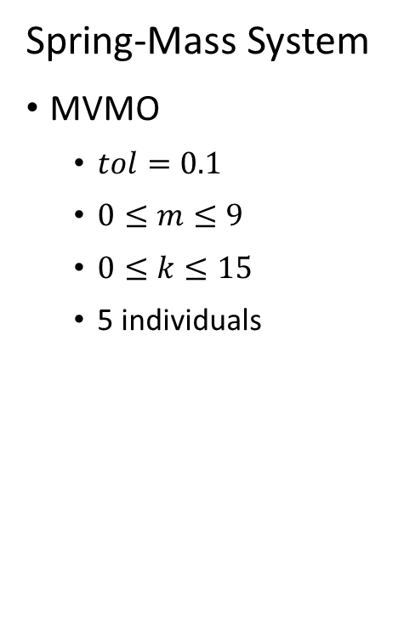
Partial Results
Spring-Mass System
MVMO
$tol=0.1$
$0≤m≤9$
$0≤k≤15$
5 individuals

Slide 54
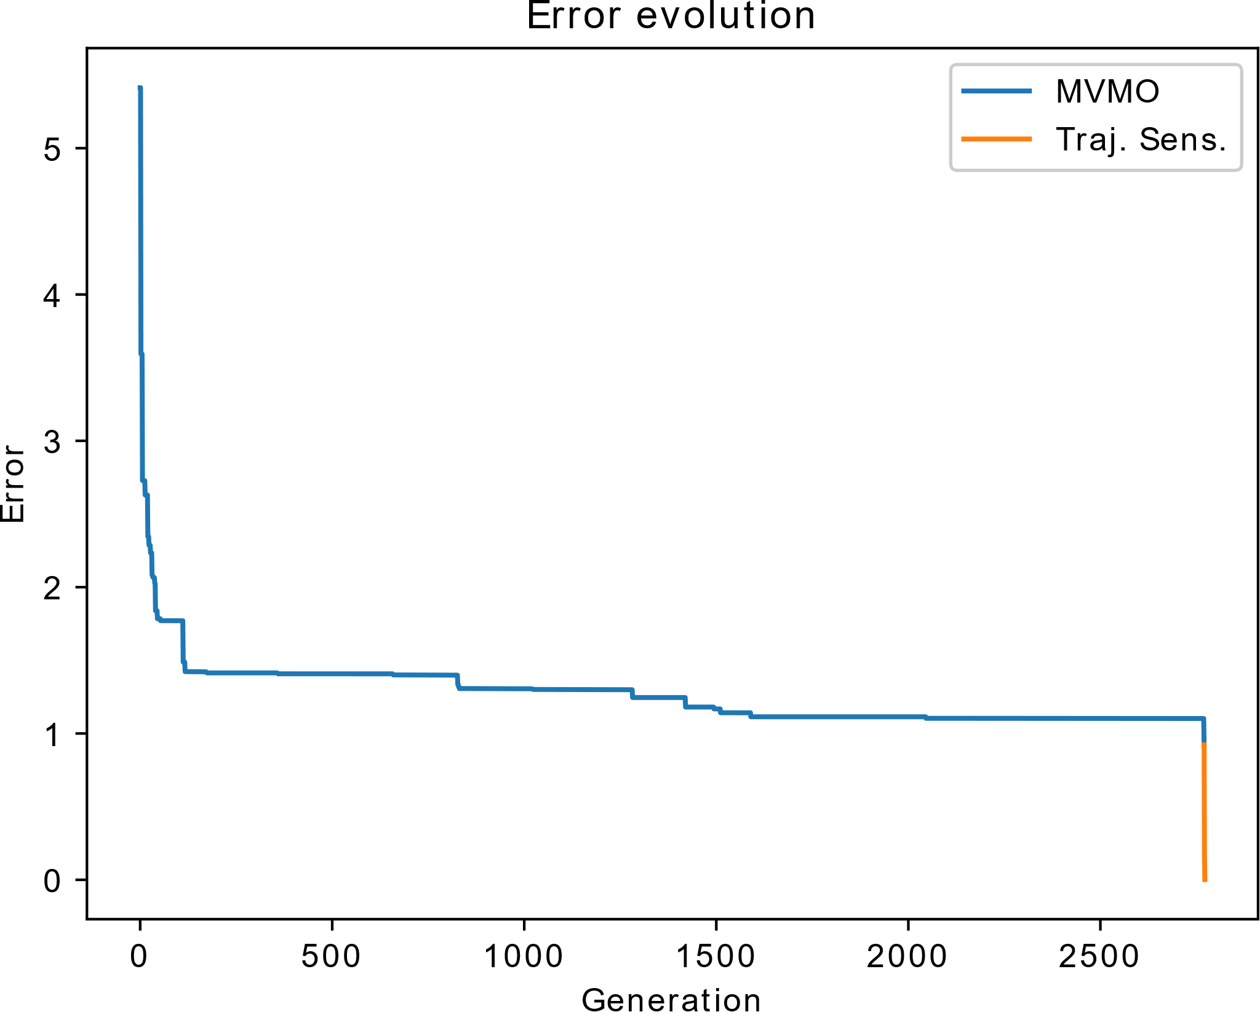
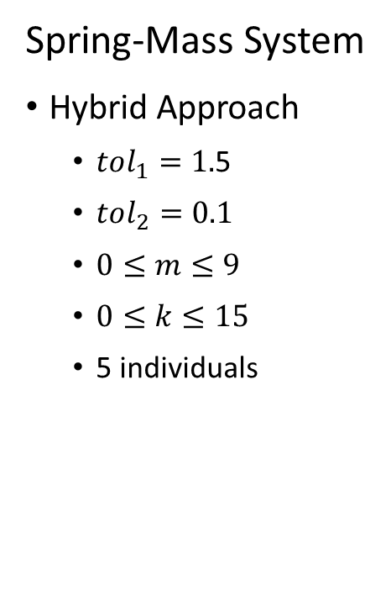
Partial Results
Spring-Mass System
Hybrid Approach
$tol_{1}=1.$5
$tol_{2}=0.1$
$0≤m≤9$
$0≤k≤15$
5 individuals

Slide 55
Partial Results
Approach | Time | Final Error
TSM | 7 s | 2.76x10^-3
MVMO | 24 min | 89.33x10^-3
Hybrid Approach | 10 min | 1.54x10^-3

Slide 56
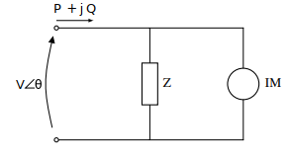
Partial Results
Linearized Z-IM Load Model
Impedance
Third-Order Induction Motor

Slide 57
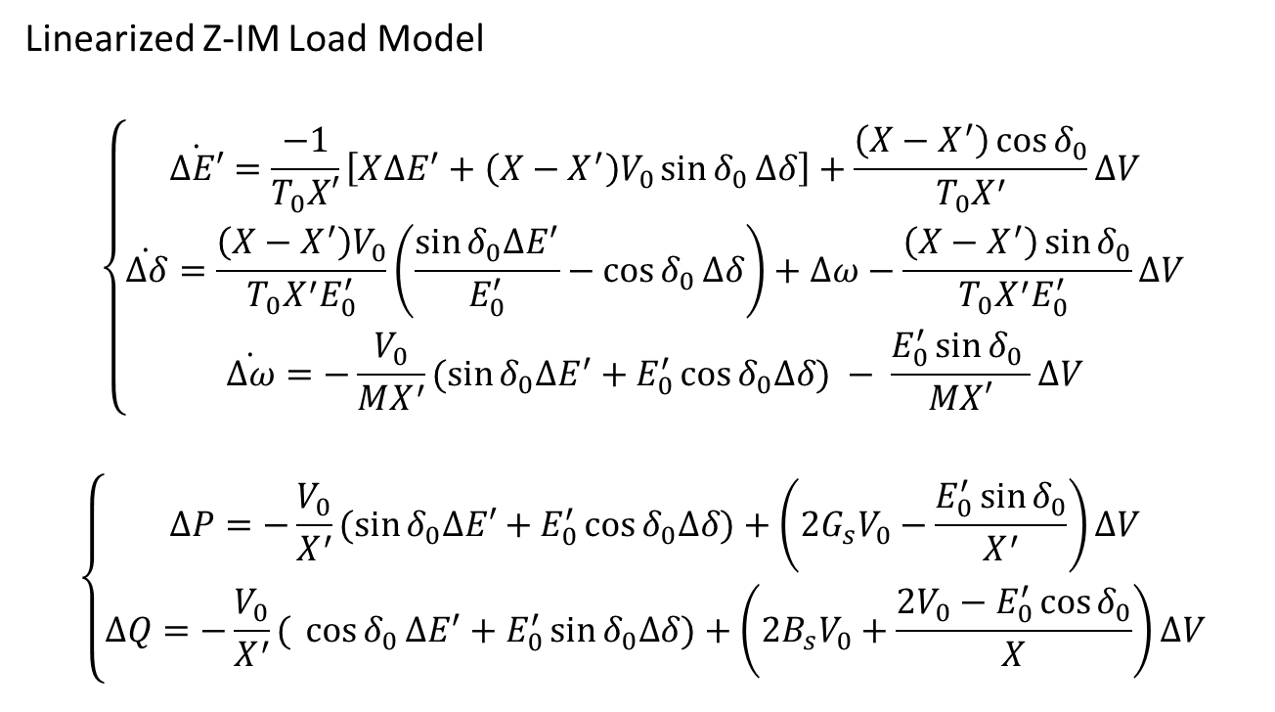
Partial Results
Linearized Z-IM Load Model
$$\left\{\begin{aligned}\dot{∆E′}=\frac{−1}{T_{0}X′}\left[X∆E^{′}+\left(X−X^{′}\right)V_{0}\sin{δ_{0}}∆δ\right]+\frac{\left(X−X^{′}\right)\cos{δ_{0}}}{T_{0}X^{′}}∆V \\ \dot{∆δ}=\frac{\left(X−X^{′}\right)V_{0}}{T_{0}X^{′}E_{0}^{′}}\left(\frac{\sin{δ_{0}∆E^{′}}}{E_{0}^{′}}−\cos{δ_{0}}∆δ\right)+∆ω−\frac{\left(X−X^{′}\right)\sin{δ_{0}}}{T_{0}X^{′}E_{0}^{′} }∆V \\ \dot{∆ω}=−\frac{V_{0}}{MX^{′}}(\sin{δ_{0}∆E^{′}}+E_{0}^{′}\cos{δ_{0}∆δ) − \frac{E_{0}^{′}\sin{δ_{0} }}{MX′}∆V}\end{aligned}\right.$$
$$\left\{\begin{aligned}∆P=−\frac{V_{0}}{X^{′}}(\sin{δ_{0}∆E′+E_{0}^{′}\cos{δ_{0}∆δ)+\left(2G_{s}V_{0}−\frac{E_{0}^{′}\sin{δ_{0}}}{X^{′}}\right)∆V}} \\ ∆Q=−\frac{V_{0}}{X^{′}}({\cos{δ_{0}}∆E^{′}+E_{0}^{′}\sin{δ_{0}∆δ)+\left(2B_{s}V_{0}+\frac{2V_{0}−E_{0}^{′}\cos{δ_{0}}}{X}\right)∆V}}\end{aligned}\right.$$

Slide 58
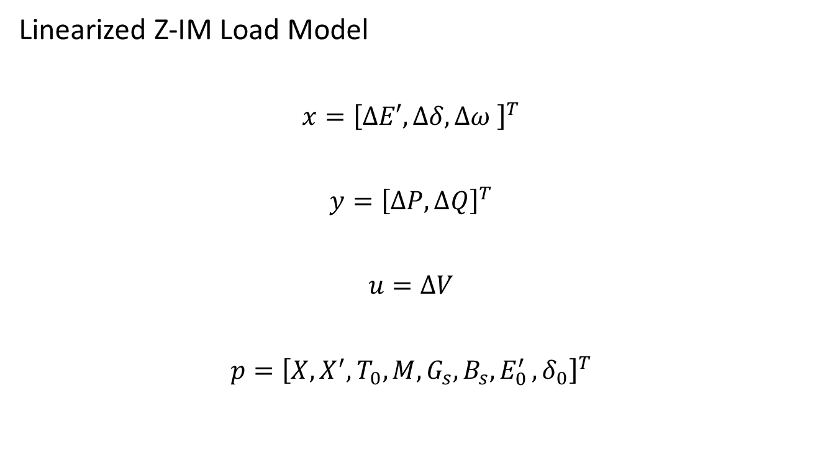
Partial Results
Linearized Z-IM Load Model
$$x={\left[∆E′,∆δ,∆ω \right]}^{T}$$
$$y={\left[∆P,∆Q\right]}^{T}$$
$$u=∆V$$
$$p={\left[X, X^{′},T_{0},M,G_{s},B_{s}{,E}_{0}^{′},δ_{0}\right]}^{T}$$

Slide 59
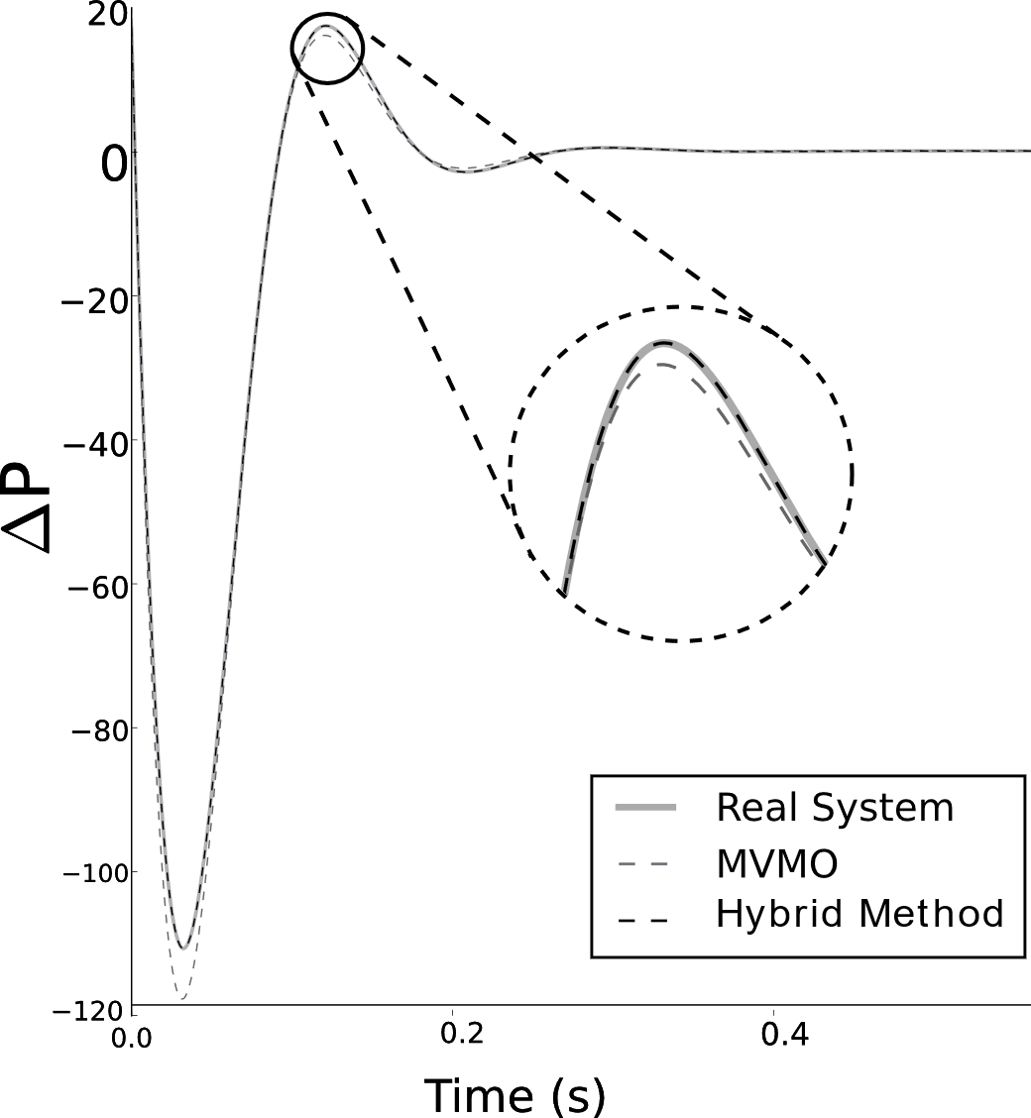
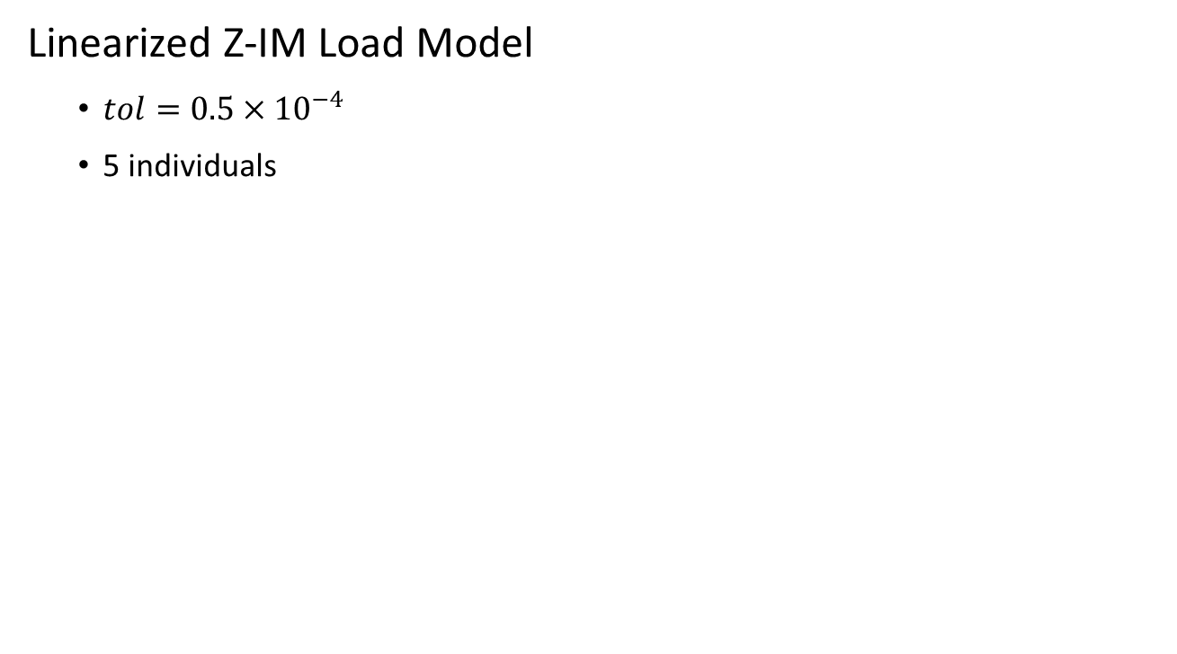
Partial Results
Linearized Z-IM Load Model
$tol=0.5×{10}^{−4}$
5 individuals

Slide 60
Next Steps
Data Acquisition | WTG Modelling | Estimation Method | GUI
Synthetic data will be obtained via simulation. | Model implemented with bad results. Improvements currently under study. | Method implemented and tested. Improvements under study. | Concept defined. Some windows have already been implemented.

Slide 61
Next Steps
Months | Oct-Dec | Jan-Mar | Apr-Jun
Data Acquisition | X | X
WTG Modelling | X | X
Estimation Method |  | X | X
GUI |  | X | X

Slide 62
Thank you!

Slide 63
Development of Software for Parameter Estimation of Wind Power Plant Equivalent
Gabriel José Negrelli Gomes
Advisor: Prof. Dr. Elmer Pablo Tito Cari
São Carlos School of Engineering - EESC
University of São Paulo - USP

Slide 64
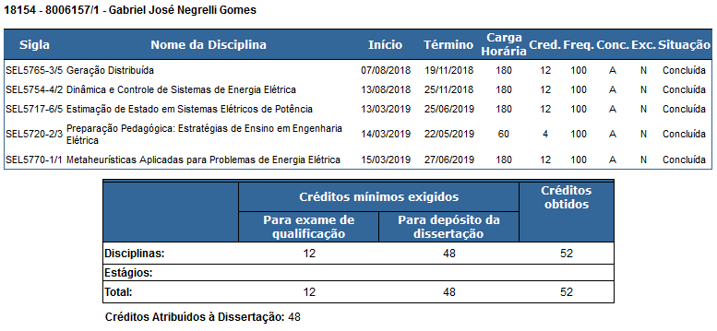
Academic Transcript

Slide 65
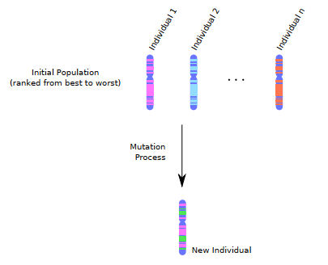
MVMO Process

Slide 66
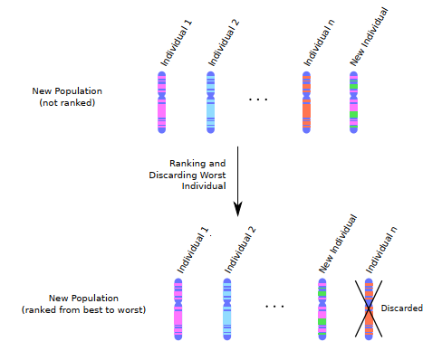
MVMO Process

